Slide 1
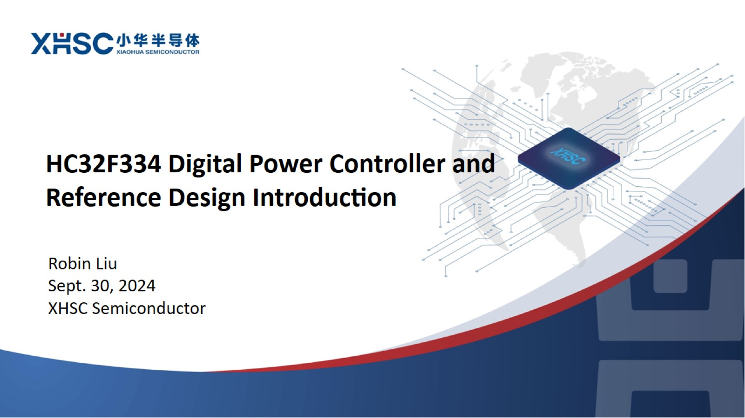

Slide 2
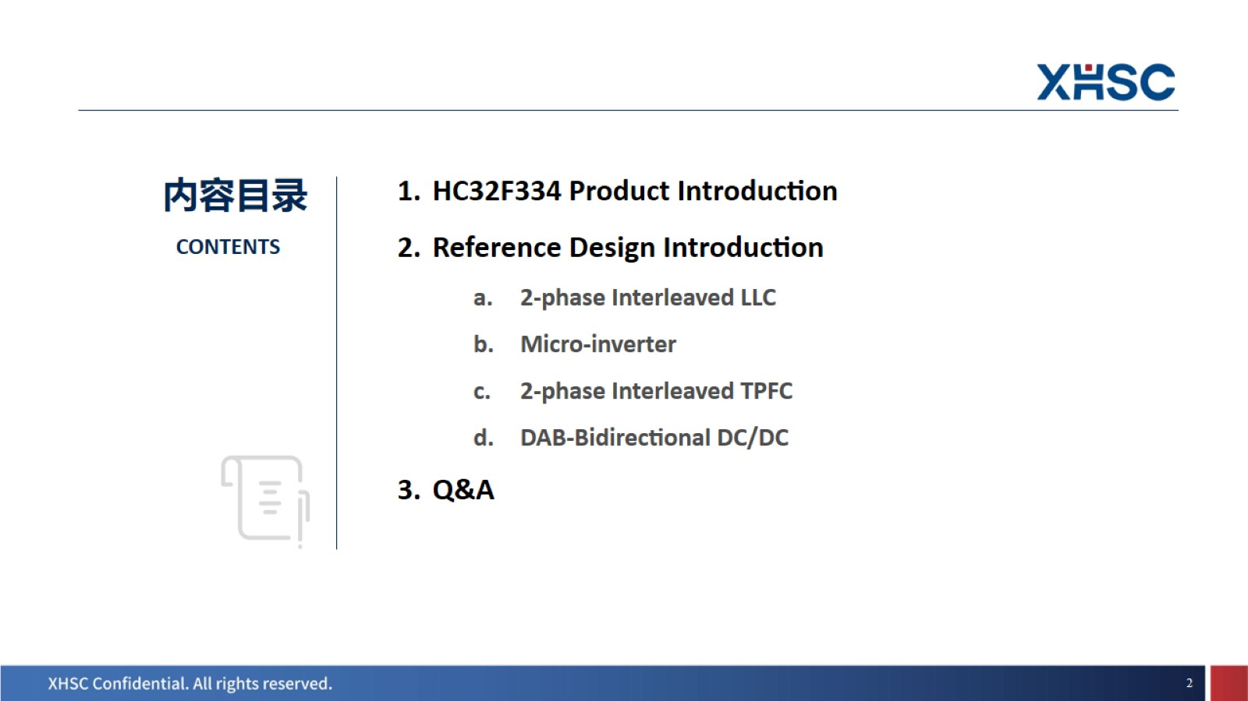

Slide 3
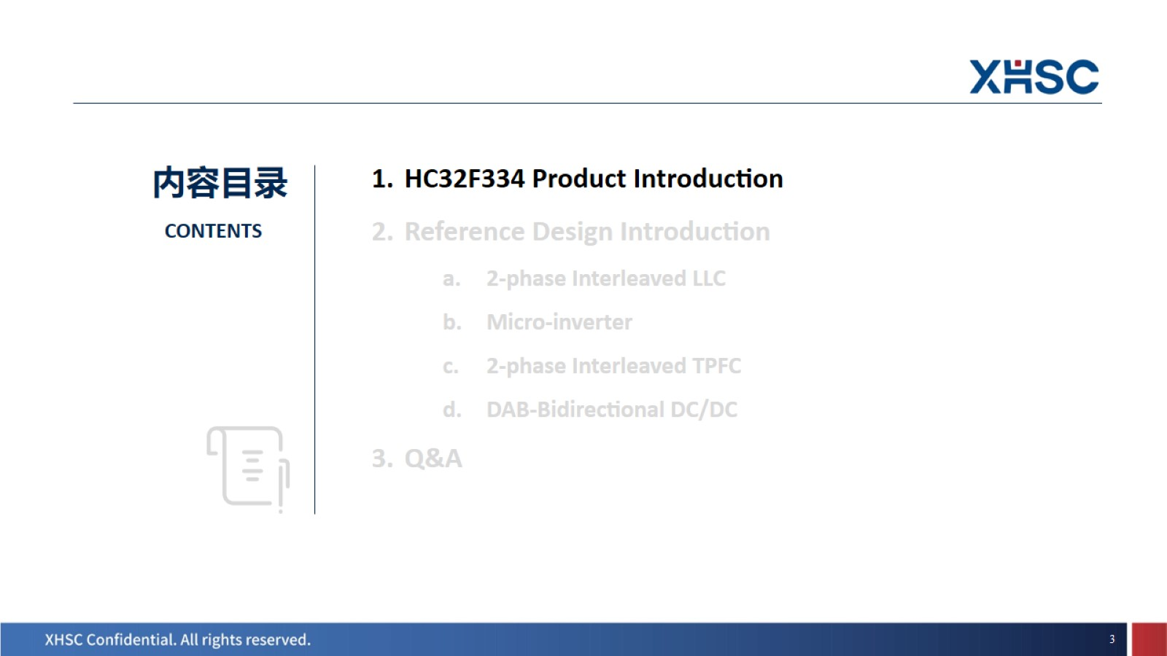

Slide 4
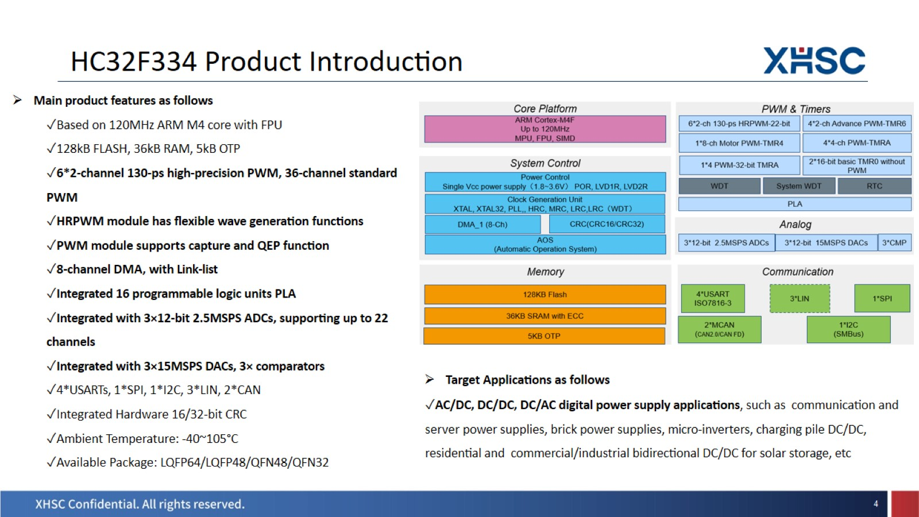
HC32F334 Product Introduction

Slide 5
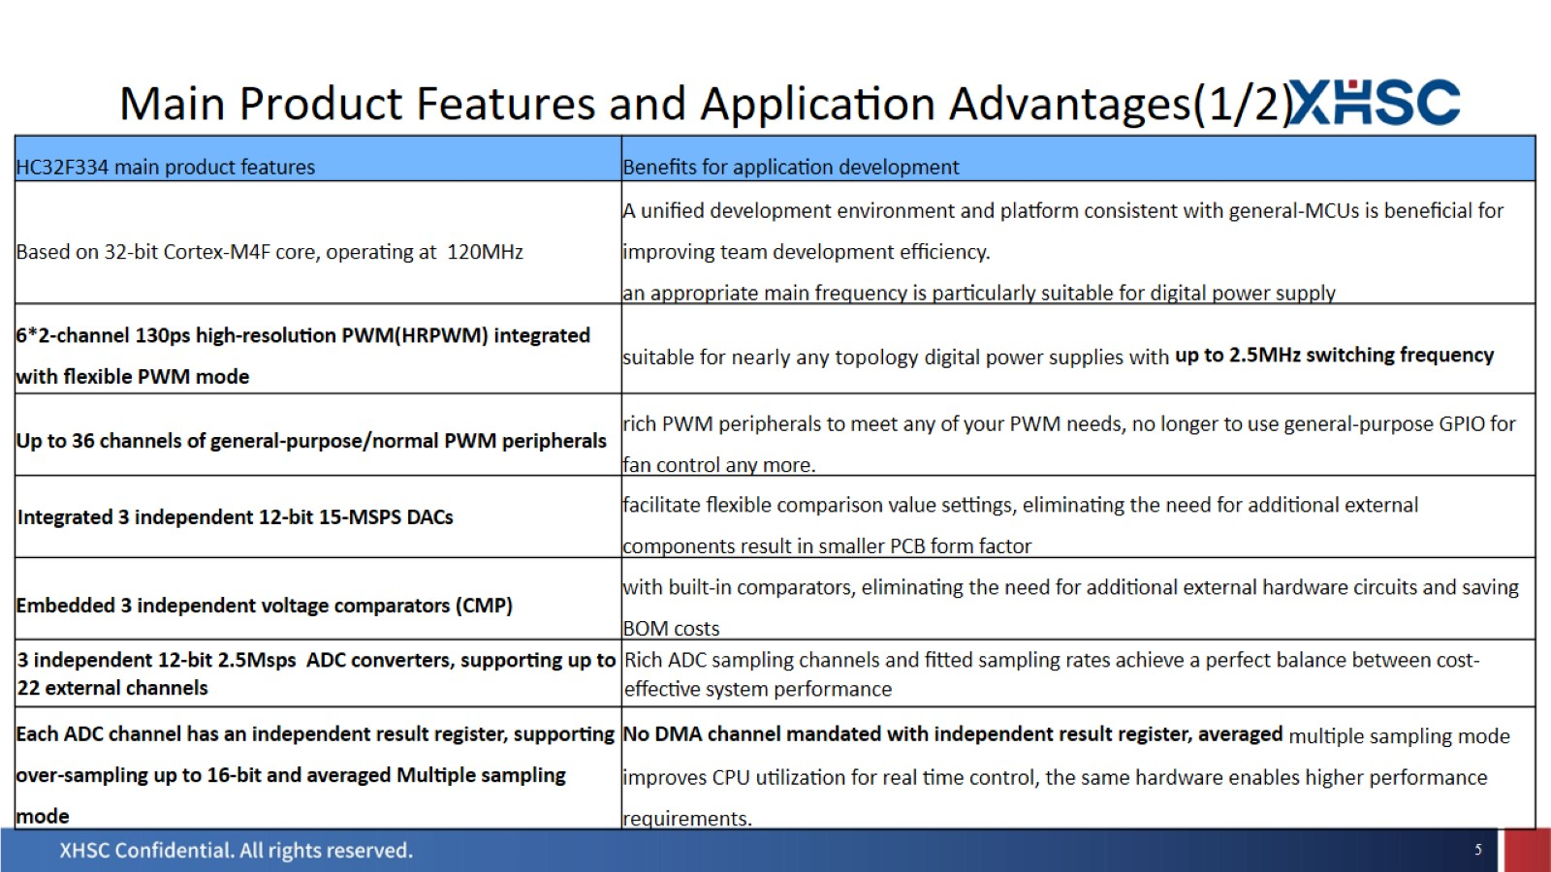
Main Product Features and Application Advantages(1/2)

Slide 6
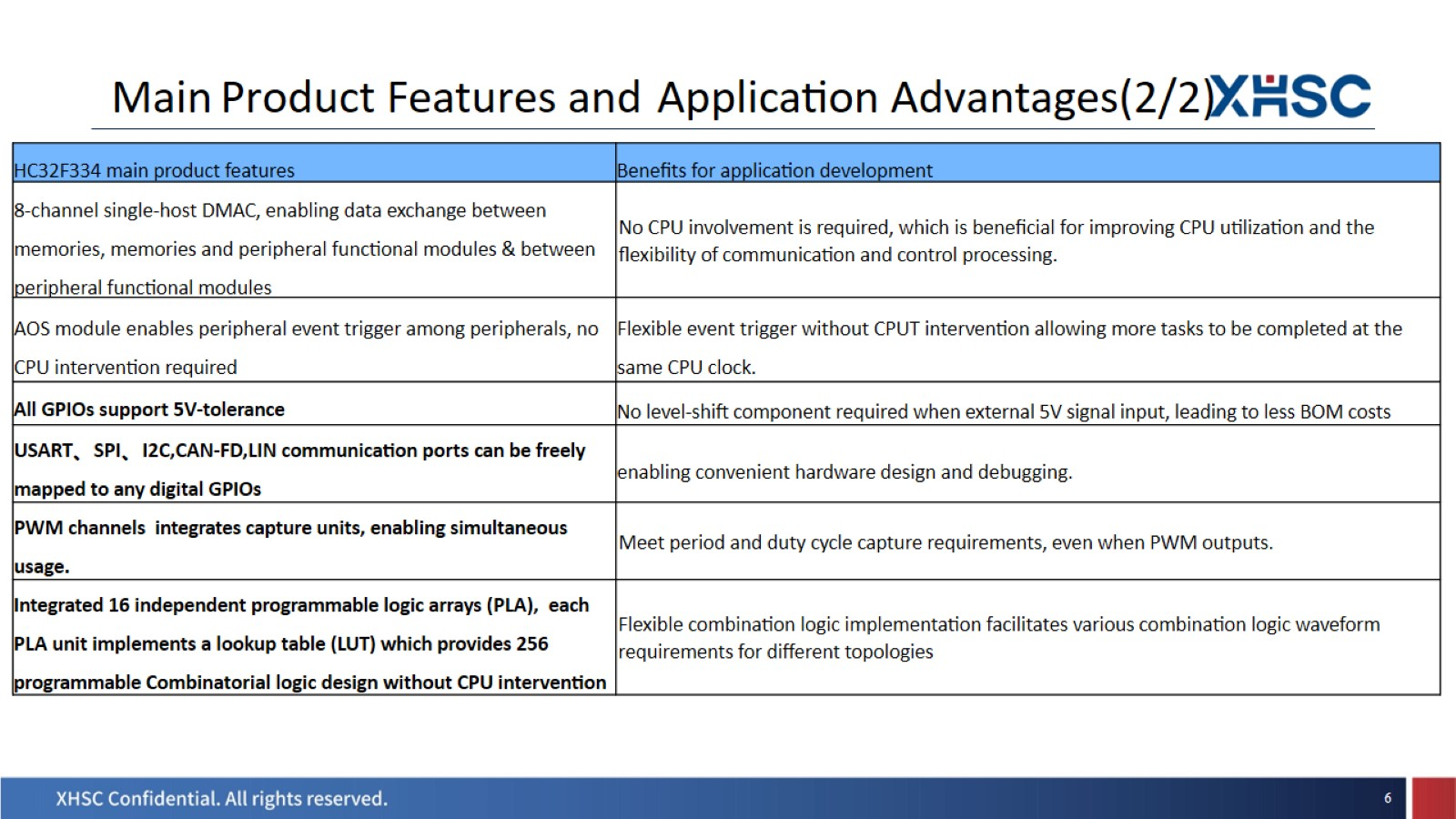
Main Product Features and Application Advantages(2/2)

Slide 7
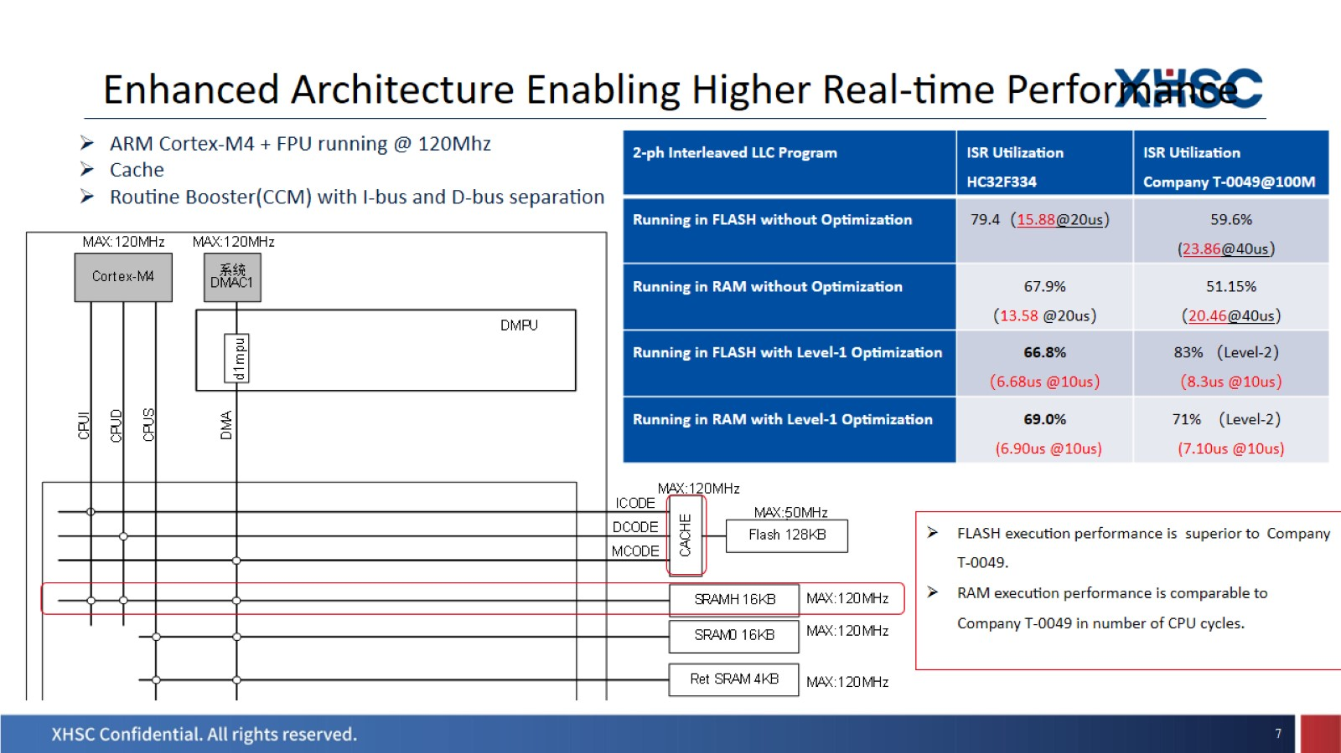
Enhanced Architecture Enabling Higher Real-time Performance

Slide 8
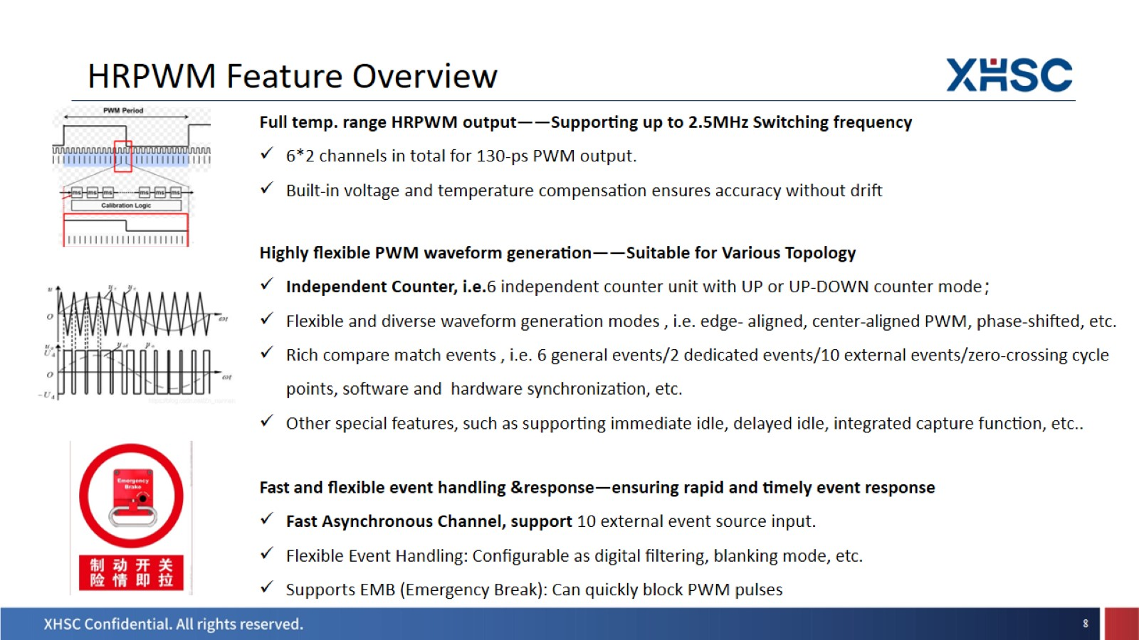
HRPWM Feature Overview

Slide 9
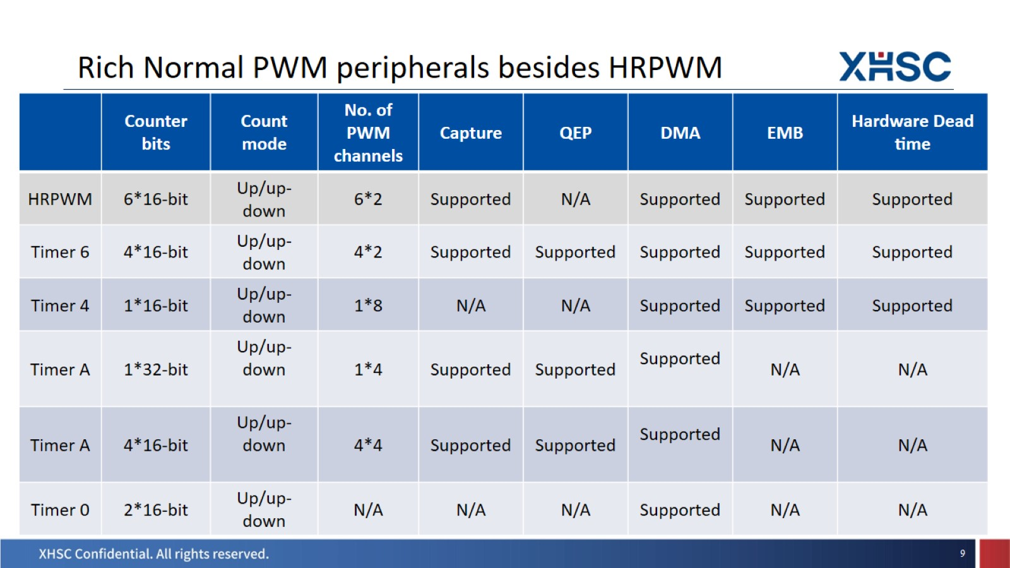
Rich Normal PWM peripherals besides HRPWM

Slide 10
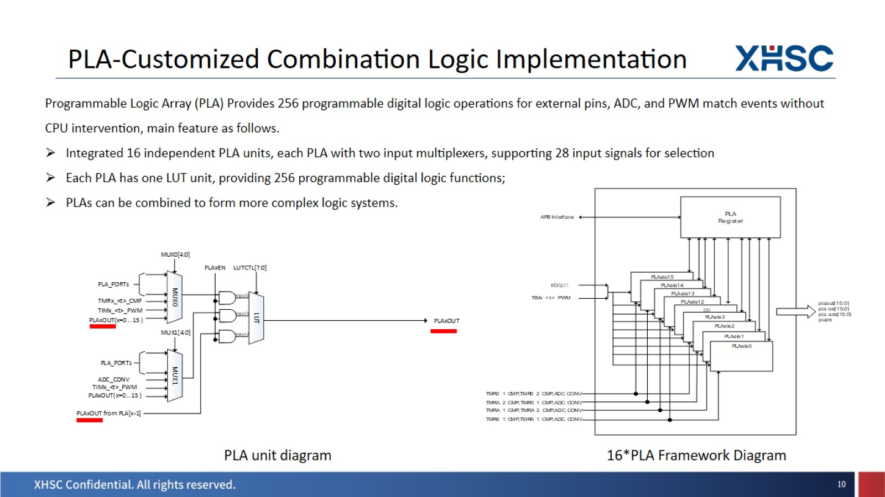
PLA-Customized Combination Logic Implementation

Slide 11
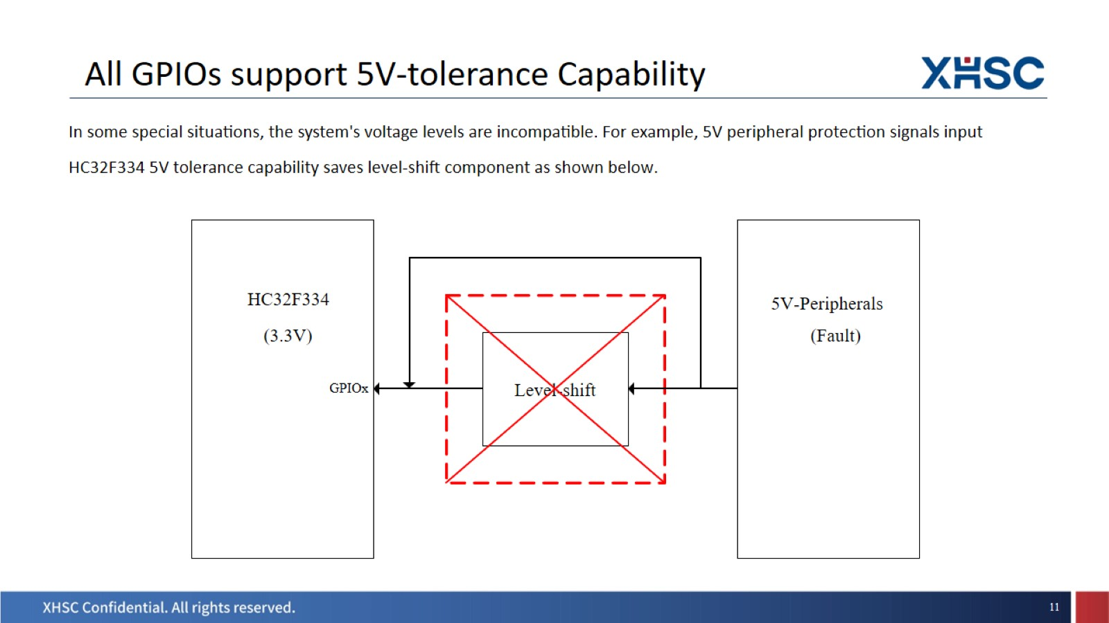
All GPIOs support 5V-tolerance Capability

Slide 12
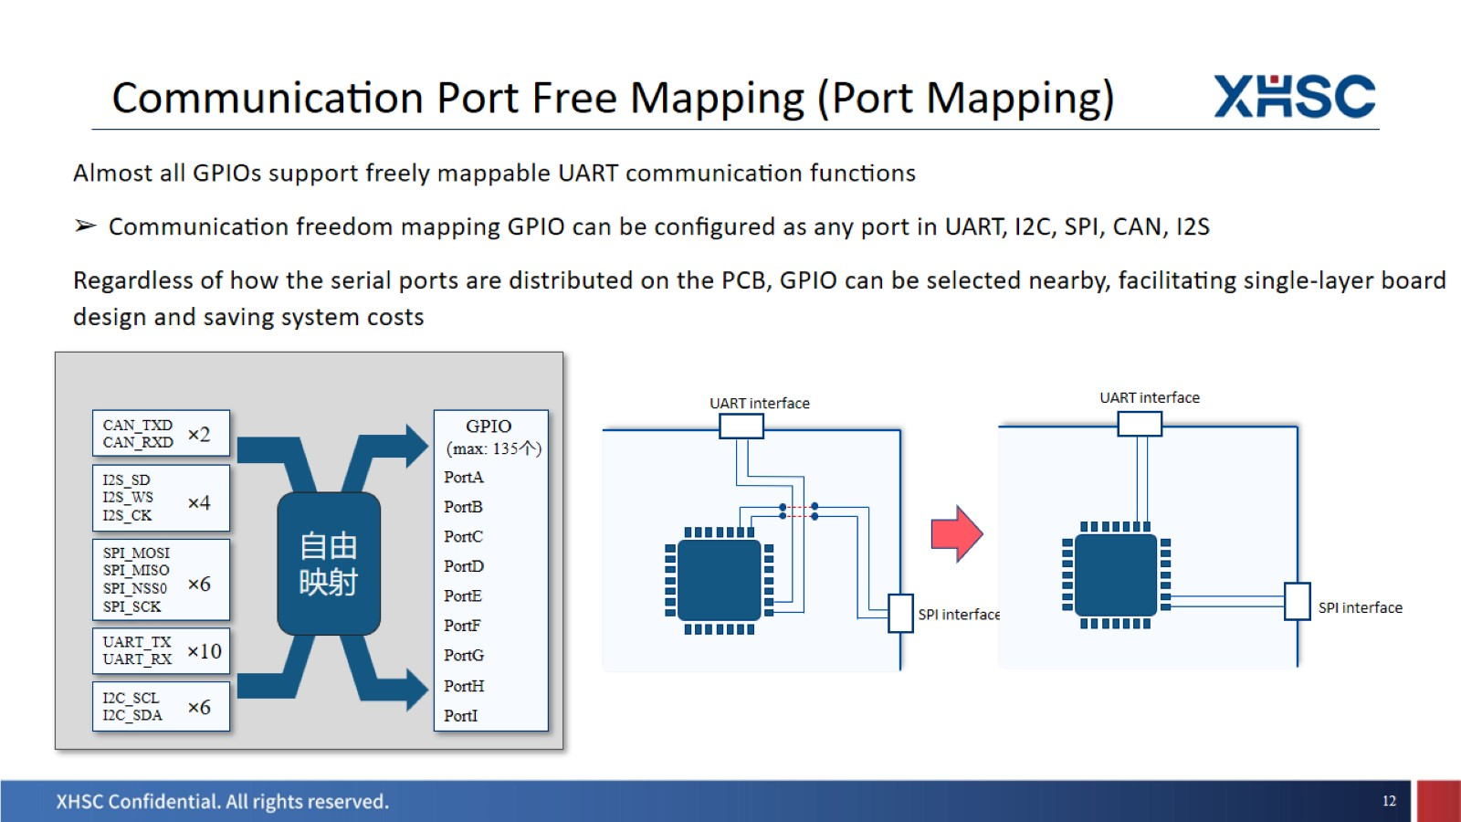
Communication Port Free Mapping (Port Mapping)

Slide 13
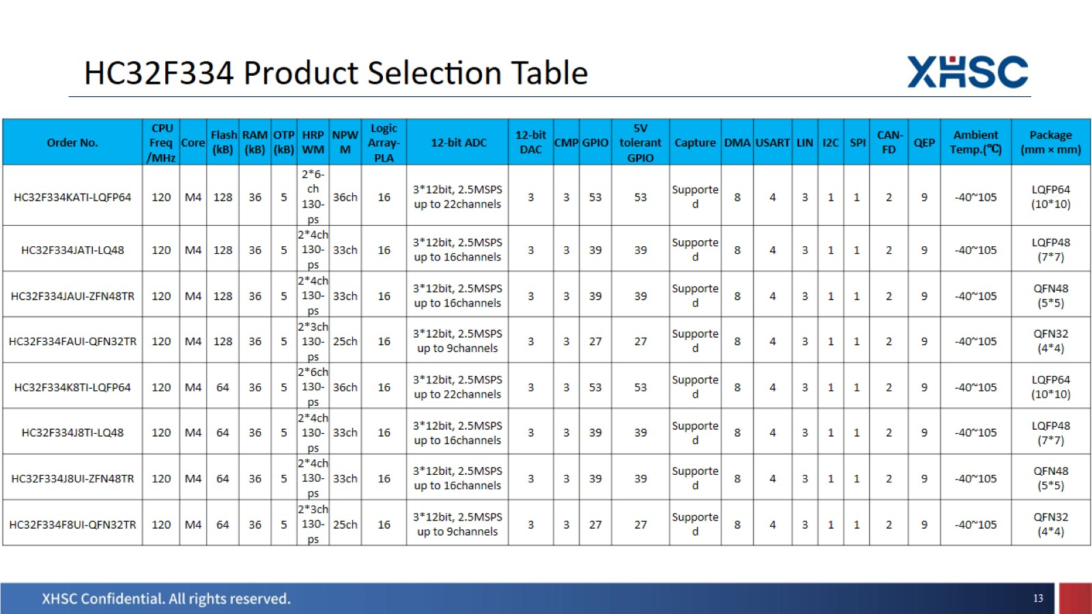
HC32F334 Product Selection Table

Slide 14
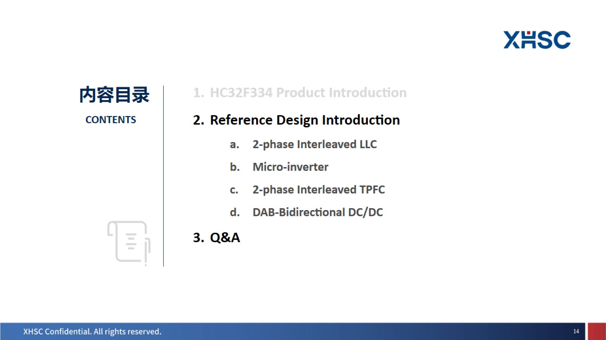

Slide 15
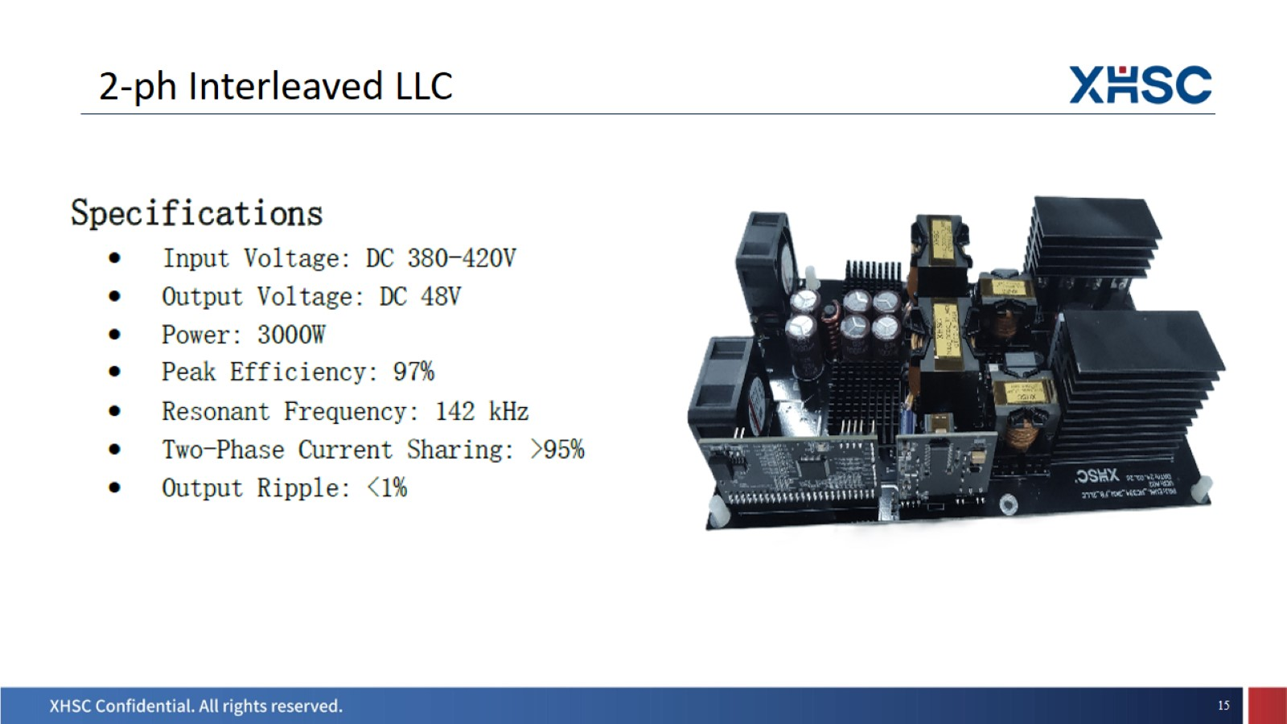
2-ph Interleaved LLC

Slide 16
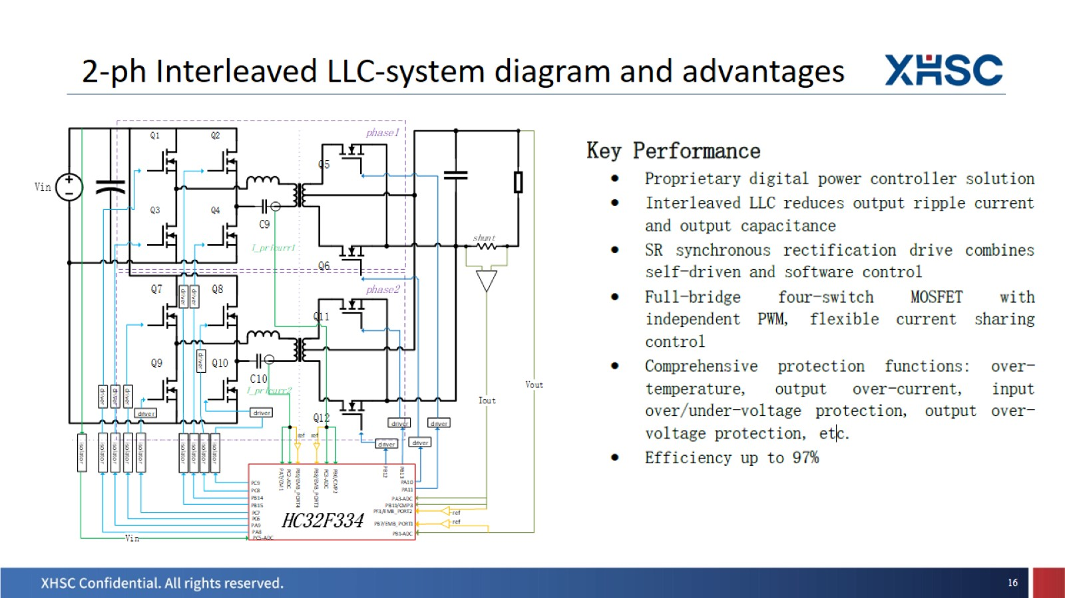
2-ph Interleaved LLC-system diagram and advantages

Slide 17
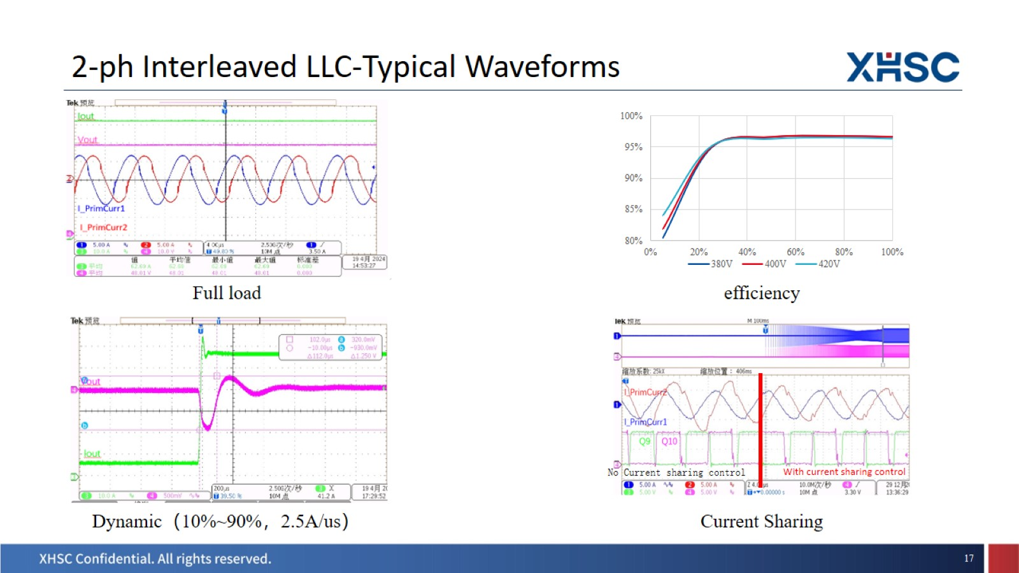

Slide 18
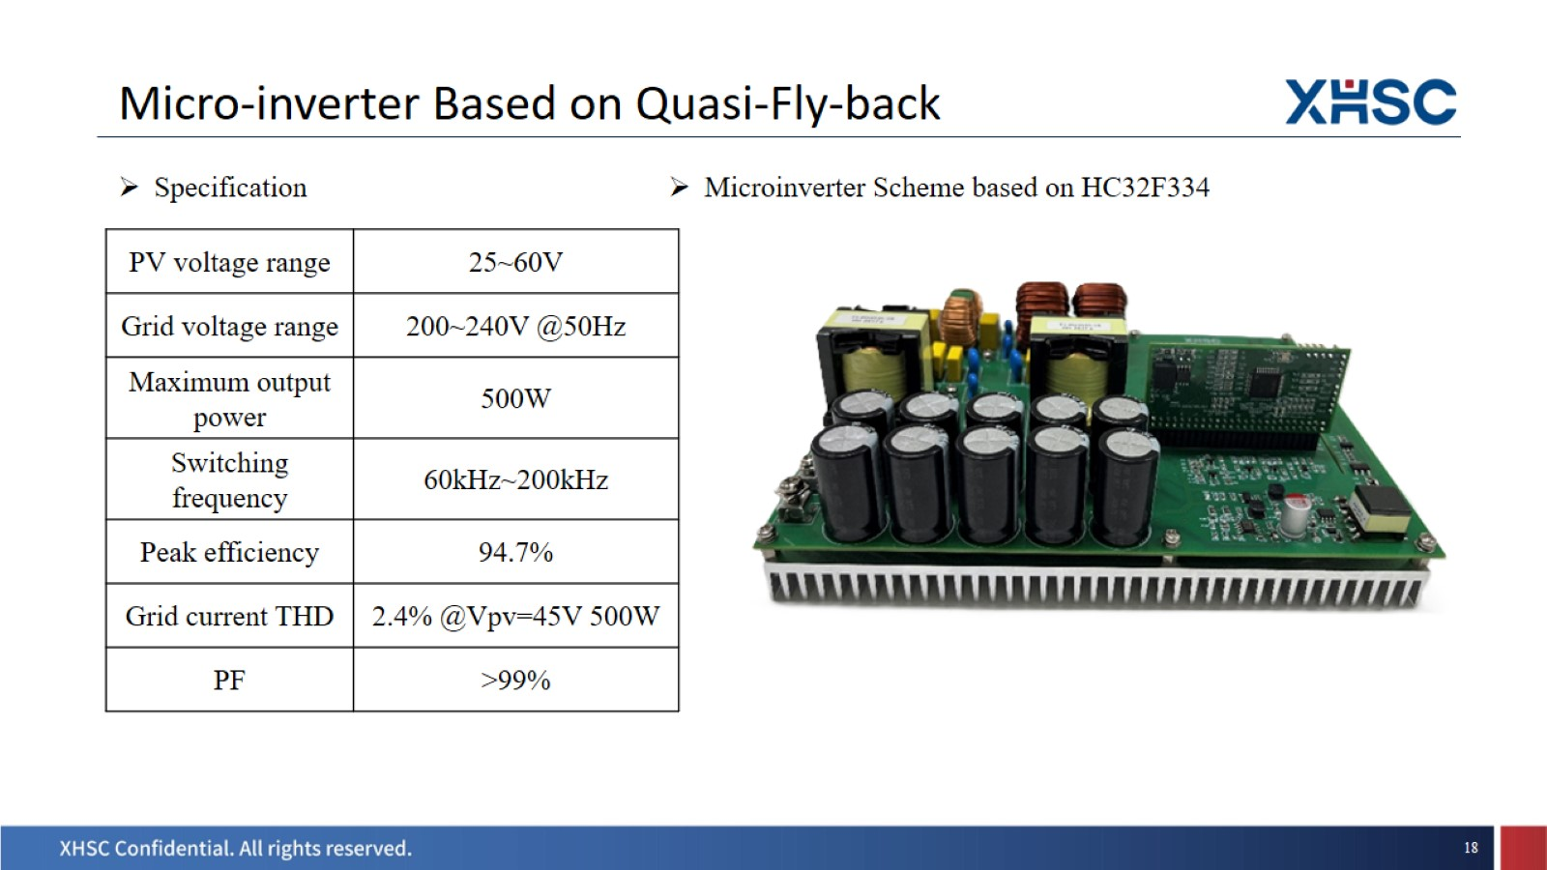
Micro-inverter Based on Quasi-Fly-back

Slide 19
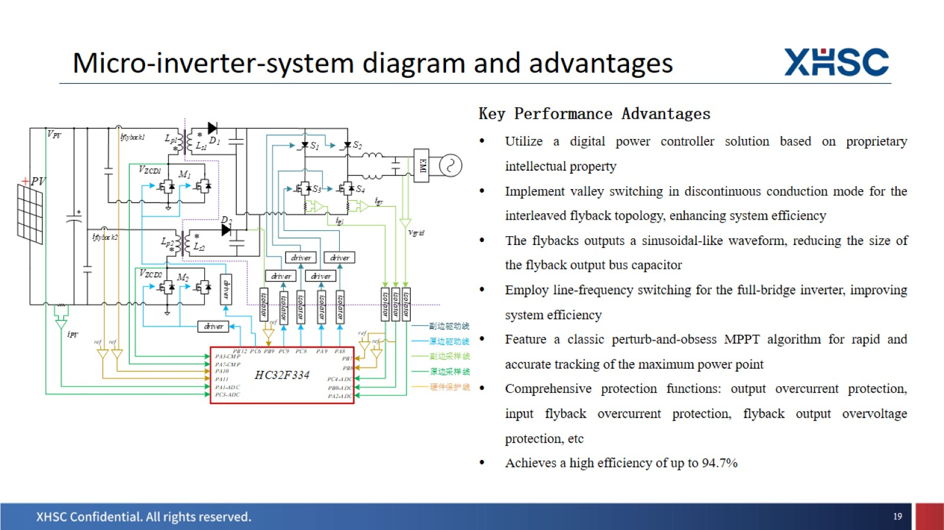
Micro-inverter-system diagram and advantages

Slide 20
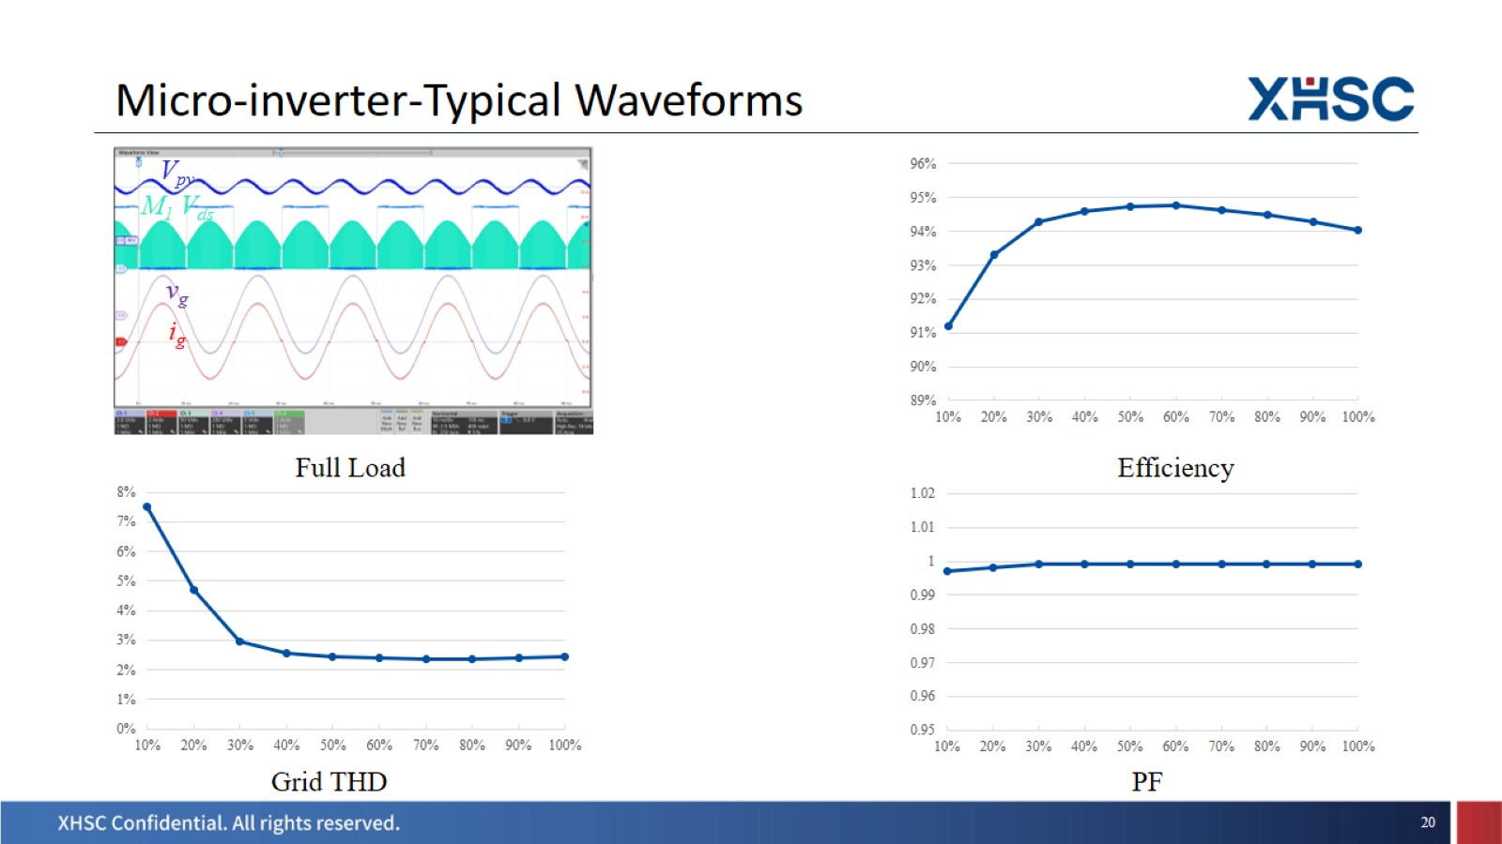
Micro-inverter-Typical Waveforms

Slide 21
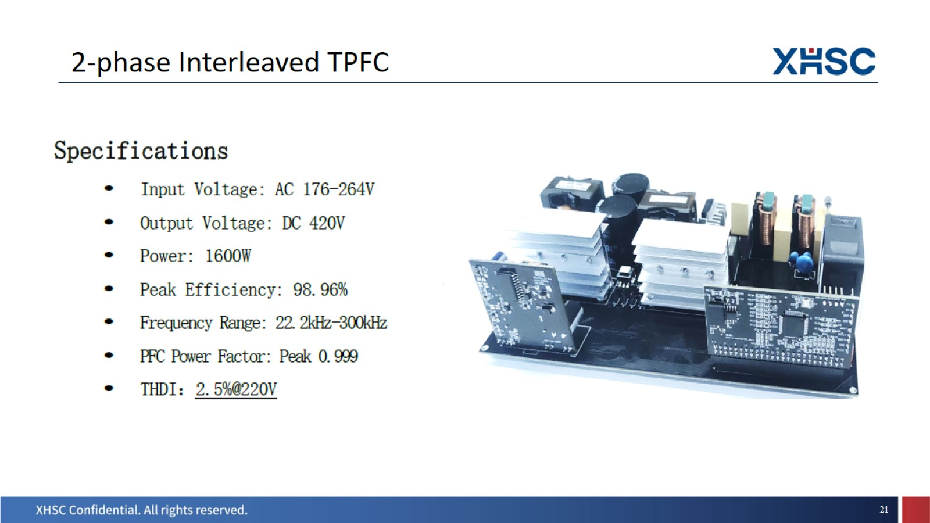
2-phase Interleaved TPFC

Slide 22
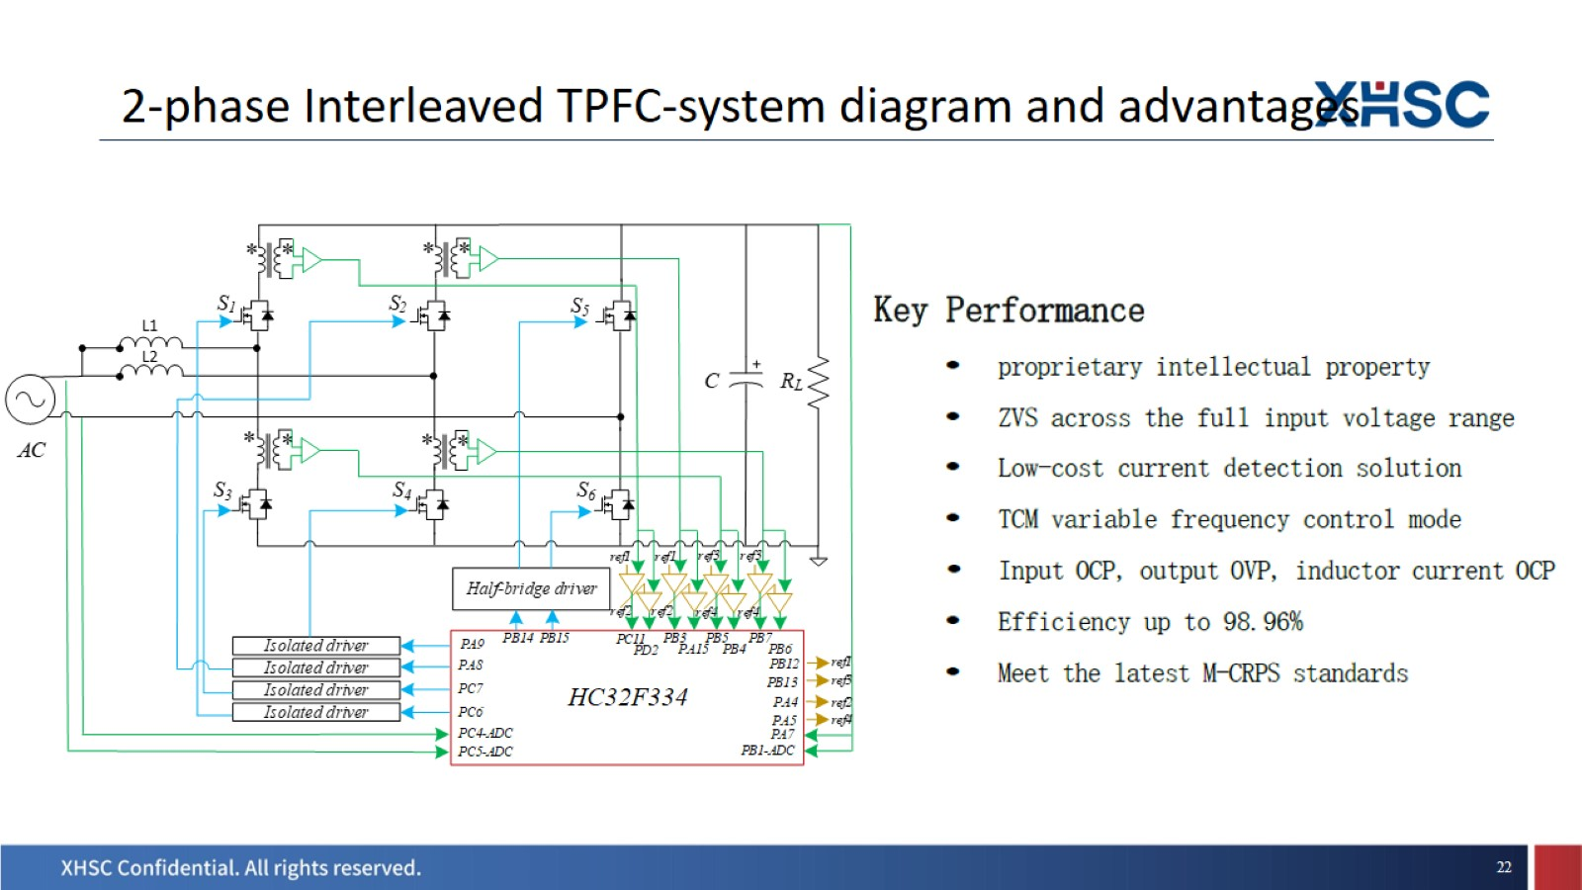
2-phase Interleaved TPFC-system diagram and advantages

Slide 23
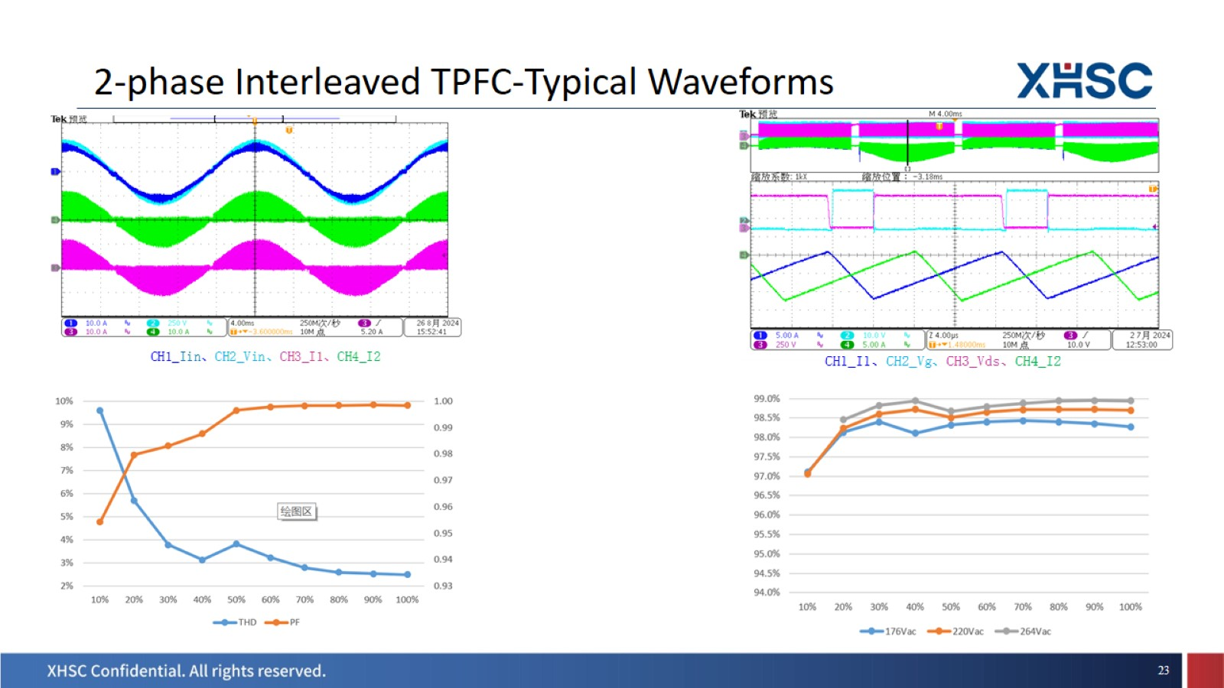
2-phase Interleaved TPFC-Typical Waveforms

Slide 24
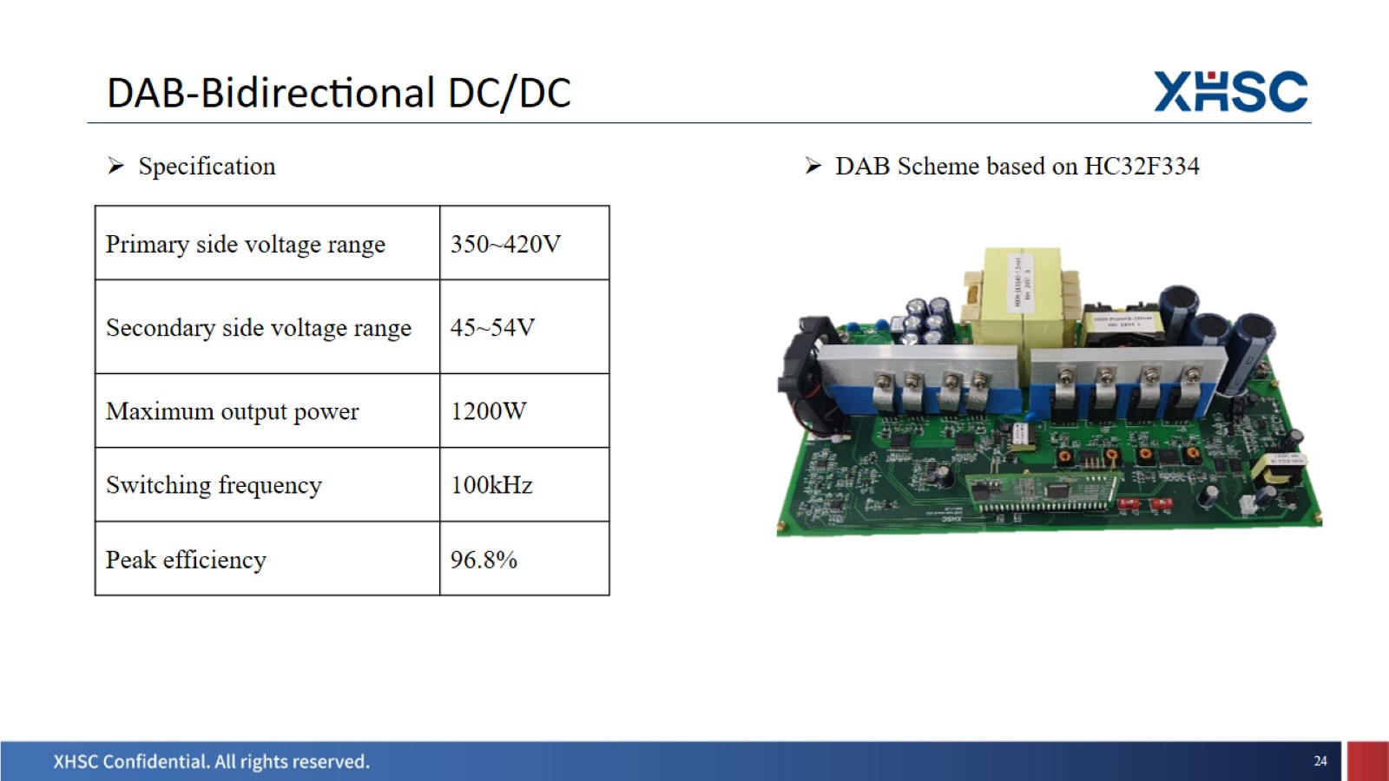
DAB-Bidirectional DC/DC

Slide 25
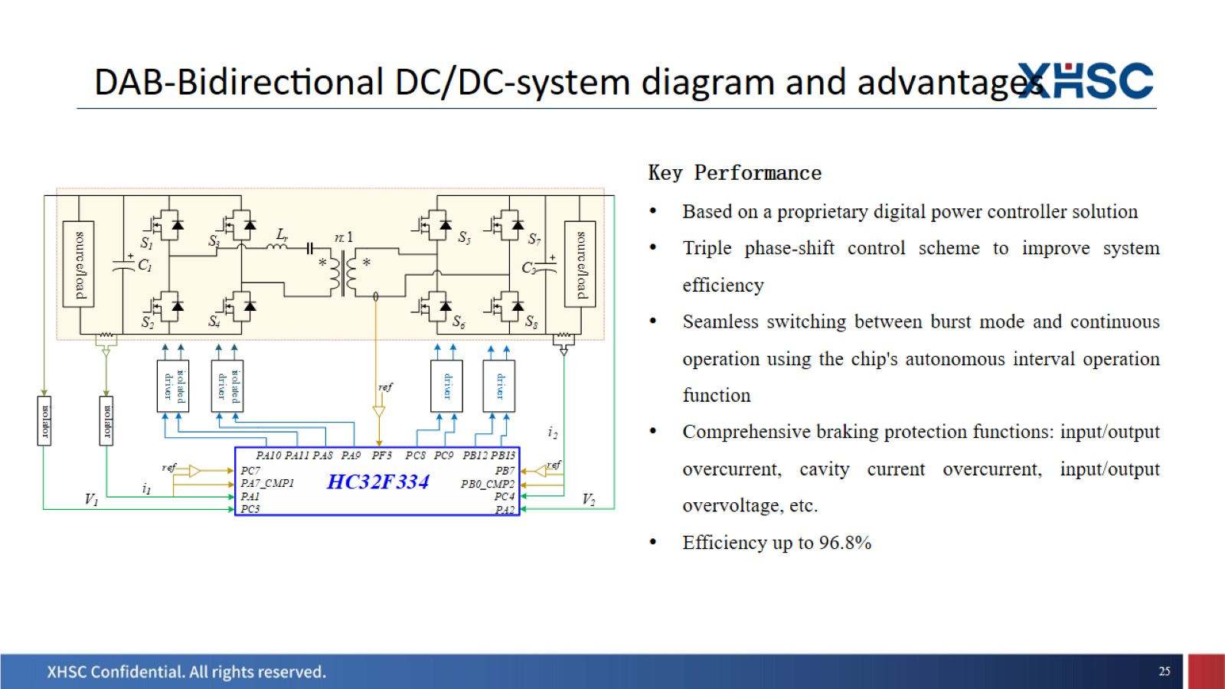
DAB-Bidirectional DC/DC-system diagram and advantages

Slide 26
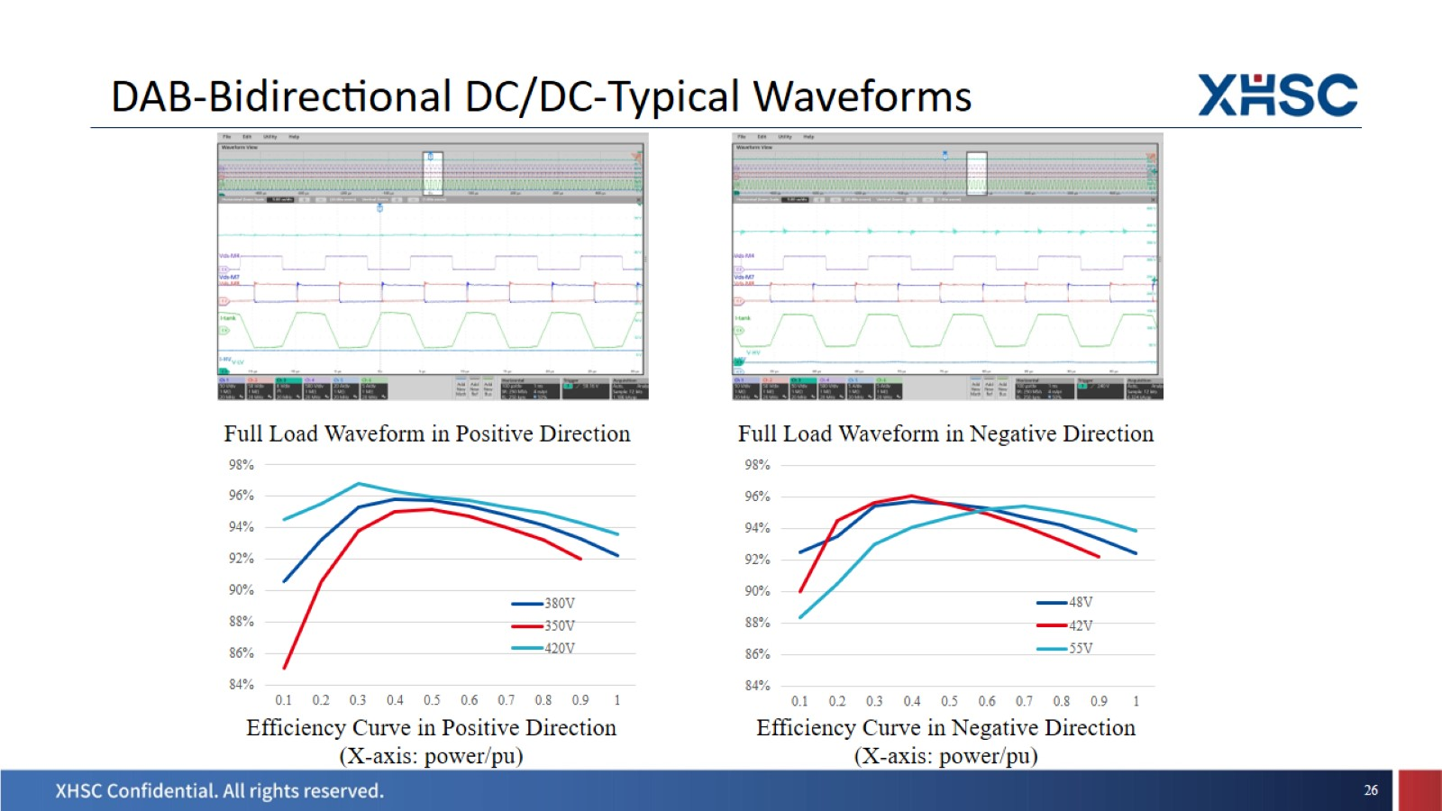
DAB-Bidirectional DC/DC-Typical Waveforms

Slide 27


